Slide 1
Chapter 3: Testing in Software Life Cycle
Software Testing
Generic Testing Types

Slide 2
System testing
Testing the behavior of the system as per SRS
Testing of a complete and fully integrated software/hardware product
Investigates both functional and non functional requirements
First level of testing where application is tested as whole.
It is black box testing
Example: Complete Pen

Slide 3
Different Types of System Testing
Usability Testing - Focuses on the user's ease to use the application
Load Testing – Checks software solution will perform under real-life loads.
Regression Testing- - Changes made over the course of the development process have caused new bugs
Recovery Testing - Software solution is reliable
Migration Testing - Software can be moved from older system infrastructures to current system infrastructures without any issues.
Functional Testing - To make sure that functionality of the product is working as per the requirements defined
Hardware/Software Testing - Check interaction of software and hardware are they working fine.
Security Testing: Check system does not allow unauthorize access

Slide 4
What Types of System Testing Should Testers Use?
Specific types used by a tester depend on several variables. Those variables include:
Who the tester works for
Time available for testing
Resources available to the tester
Software Tester's Education
Testing Budget

Slide 5
Acceptance Testing
Check whether system meets user needs and expectations.
The purpose is to evaluate the system’s compliance with the business requirements and assess whether it is acceptable for delivery.
The goal of acceptance testing is to establish confidence in the system.
Acceptance testing is most often focused on a validation type testing.

Slide 6
Forms of Acceptance Testing
There are various forms of acceptance testing:
Contract acceptance Testing
- Based on criteria and specifications which are predefined and agreed upon in a contract.
User acceptance Testing
- Testing a software by the user/client to determine whether it can be accepted or not first organization employees test software
Operational acceptance Testing
- Testing assures the acceptance of the system by the system administrators.
Field Testing (alpha and beta testing)
- Alpha Testing takes place in development environment
- Beta Testing takes place in customer’s environment

Slide 7
Generic Types of Testing
The following types of testing can be distinguished:
Functional Testing
- describe the functionality of the software system
Non functional testing
- describe the behaviour of the software system etc
Testing of software structure
- objective is to design and run enough test cases to completely cover all structural items.
Testing related to changes and regression testing
- When changes are implemented, parts of the existing software are changed so regression testing may be performed.

Slide 8
Functional Testing
Describe the behaviour/execution of the software system
Functional requirements are the what i.e what the system does
Ensures proper working of all the functionalities of an application
Ensures all the requirements are met
Produces a defect-free product
Analyze integrating pieces of an application
Example: Website to pay utility bills

Slide 9
Functional Testing
Five steps need to be keeping in mind for functional testing:
Preparation of test data based on the specifications of functions
Business requirements are the inputs to functional testing
Based on functional specifications find out of output of the functions
The execution of test cases
Observe the actual and expected outputs

Slide 10
Non Functional Testing
Emphasizes the behaviour of the product and not the functionality
Non functional testing will answer How.
It increases the ease of use, efficiency, maintainability, and portability of the product.
It helps reducing production risk and the cost associated with non-functional aspects of the product.
Optimize the way the product is installed, configured, executed, managed and monitored.
Improve and enhance the knowledge of the behaviour of the product and its uses.
Example: Website to pay utility bills (application security, page loading)

Slide 11
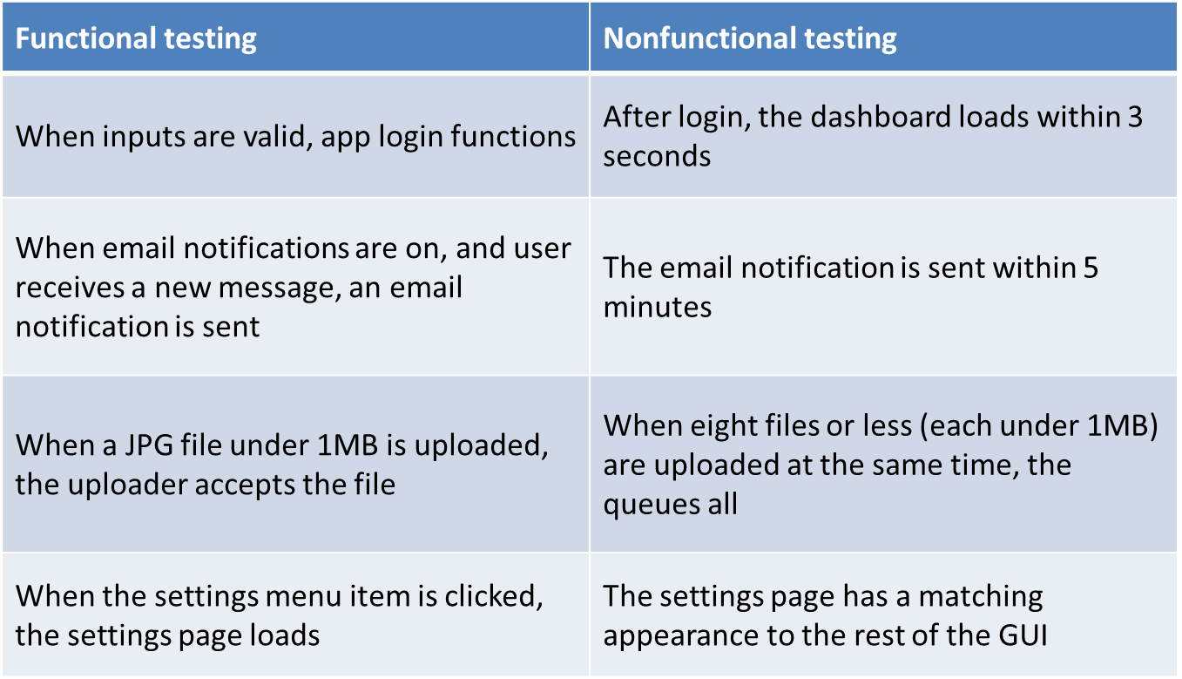
Functional Vs Non Functional Testing with example

Slide 12
Testing Related to Changes and Regression Testing
When changes are implemented, parts of the existing software are changed or new modules are added
Regression Testing is nothing but a full or partial selection of already executed test cases which are re-executed to ensure existing functionalities work fine.
How much retest and regression test?
Re-running of all the tests that have detected failures whose reasons have been fixed in the new software release
Testing of all program parts that were changed or corrected
Testing of all program parts or elements that were newly integrated Testing of the whole system

Slide 13
Selection of regression test cases
Repeating only the high-priority tests according to the test plan
In the functional test, omitting certain variations (special cases)
Restricting the tests to certain configurations only
Restricting the test to certain subsystems or test levels

Slide 14
Thank you

